Slide 1
Information Systems in Emirates Airline
Presented by
Manik Mahashabde (10518579)
Prasad Rane(10520526)
Saurabh Devade(10531140)

Slide 2
Introduction
This artefact provides insights and research on various information systems used in Emirates Airline.
Some of the major information systems discussed in this artefact are Customer Relationship Management(CRM), Supply Chain Management(SCM), Management Information System(MIS), Transaction Processing Systems(TPS) etc.
This artefact is focused on research involved in how Emirates as an Airline has benefitted from these information systems in terms of their business and retaining customers.

Slide 3
About Emirates
Emirates is the national Airline of Dubai founded by Dubai’s royal family Al Maktoum in the year 1985.
Emirates started its Airline business by leasing two Boeing aircrafts 737-300 and Airbus300 from Pakistan International Airlines.
The Airlines first flight, flight EK600 was Dubai-Karachi on 25th October 1985.
Then after Emirates has never recorded a loss in its operations due to business modal it follows.
In early 2000 Emirates started implementing CRM for better customer experience.
In 2004 Emirates faced issue in functioning of aircraft management, hence they implemented supply chain management.

Slide 4
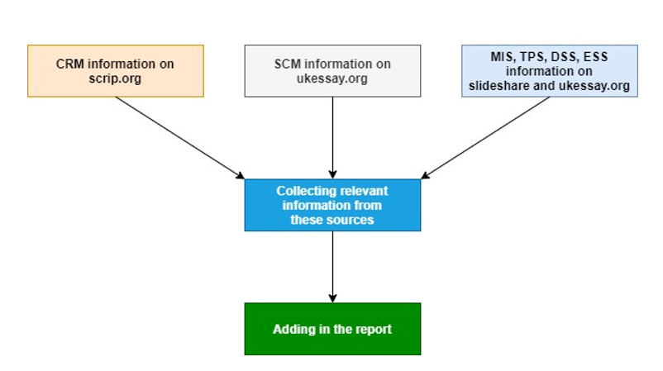
METHODOLOGIES

Slide 5
CRM in EMirates
CRM in Emirates involves 3 major elements : Sales Force Automation, Customer Service and Marketing Automation.
Emirates was the first company in middle-east to use CRM software in Airline industry popularly called as KIS(Knowledge-Driven Inflight Service).
Two major aspects in Emirates CRM are Windows 8 CRM and Loyalty program based CRM.
In Windows 8 CRM, Emirates used its proprietary Software KIS which used specific CRM database which ran along the flight to collect relevant data from customers based on their preferences.
The loyalty program in Emirates involved Emirates Skywards and Business rewards which locked down customers to Emirates Airline to enjoy benefits in terms of discounts and pricing.

Slide 6
SCM in EMirates
Present Supply chain management of Emirates can be divided into majorly 3 sections.
Emirates Engineering provides top quality aircrafts and facilities to Emirates groups so that it can meet requirements of the customers.
Product Support Agreements(PSA’s) are signed between Procurement Departments to ensure smooth and timely delivery and maintenance of aircraft for Emirates.
Suppliers having agreements are know as direct suppliers who ensure finest of raw materials are provided for manufacturing the fleet with precision.

Slide 7
MIS and DSS of EMirates
Management Information Systems in Emirates involves decision making at Strategic, Tactical and Knowledge level, these decision are mostly unstructured and are based on use of supporting information systems like Executive Support System (ESS) and Decision Support system(DSS).
In Emirates MIS play a vital role in Analyzing & Reporting of flight schedules, Budget System and pricing analysis of air tickets.
Decision Support Systems helps Emirates management to make decisions in situation where there is uncertainty about possible outcomes of the decisions taken, compensation analysis in terms of business strategies planning can also be achieved by DSS.
Knowledge based decisions are made by engineers and designers and may involve decisions regarding new marketing availability depending on the functioning of the company.

Slide 8
ESS and KIS in Emirates
Executive Support Systems is a type of information system which is used at strategic level which helps senior managers in Emirates to make strategic decisions which may involve decisions regarding adding new destinations or buying new airplanes.
KIS is proprietary Emirates system which stands for Knowledge-Driven Inflight Service, which is a competitive intelligent system that uses specific CRM database which runs through the flights to maintain a profitable and long-term relationship with customers.

Slide 9
TPS and OPS
TPS stands for Transaction Processing Systems, Emirates uses TPS system to support the transaction and analytical processing of newly received operational information.
Order processing system is type of information system that keeps track of daily orders and transactions.

Slide 10
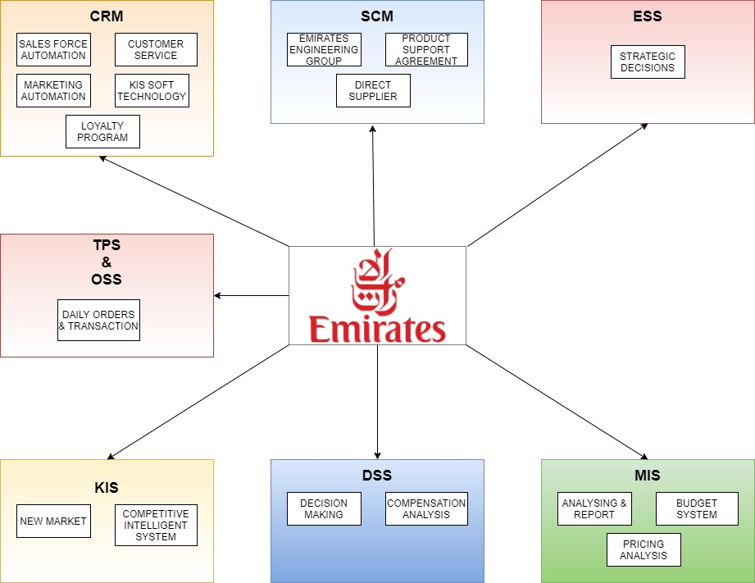
Eis diagram for emirates

Slide 11
Recommendations
In this artefact we would like to recommend Emirates Airline to include Artificial Intelligence(AI) technology for identification of their passengers at the Airports.
This technology will boost overall travel experience for passengers at the Airports travelling with Emirates.
AI can also be used for customer handling which will result in reduction of operational and labor cost.
Moreover AI can be implemented in number of other ways like Air Traffic Management, Baggage Screening and Aircraft maintenance.

Slide 12
Thank you
Any Questions?

